Slide 1
Los Angeles Save Bike Lanes
Martin Ledl 108012012
Pawel Urbanowicz 108015016

Slide 2
Team Members
Martin Ledl 108012012
Pawel Urbanowicz 108015016

Slide 3
Outline
Introduction
Datasets
Data Preprocessing
Data Analysis
Conclusion

Slide 4
Introduction
Goal:
Provide an analysis of safety of bike lanes in Los Angeles
Analysis of most frequent committed crimes
Analyse which crimes might affect bikers
Timely analysis of frequent committed crimes
Analysis of shared bike trips
Analysis of provided bikelanes
Combine results to extract pattern

Slide 5
Datasets
Arrest Dataset
Metro Bike Share Trip Dataset
Bike Lanes Dataset

Slide 6
Arrest Dataset
Source
https://data.lacity.org/A-Safe-City/Arrest-Data-from-2010-to-Present/yru6-6re4
Stats
Owner: LAPD
Refresh rate: Weekly
Columns: 17
Rows: 1.32M
Each row represents the booking of an arrestee

Slide 7
Metro Bike Share Trip Dataset
Source
https://data.lacity.org/A-Livable-and-Sustainable-City/Metro-Bike-Share-Trip-Data/sii9-rjps
Stats
Owner: Mayor's Office
Refresh rate: Quarterly
Columns: 1
Rows: 132K
Each row represents a trip with a shared bike

Slide 8
Bike Lanes Dataset
Source
https://data.lacity.org/A-Livable-and-Sustainable-City/Bikelanes/uzvv-a9xz
Stats
Owner: Department of Transportation
Refresh rate: Not specified
Feature Collection of different named features that describe the different bikelanes
Current Number of Features: 806

Slide 9
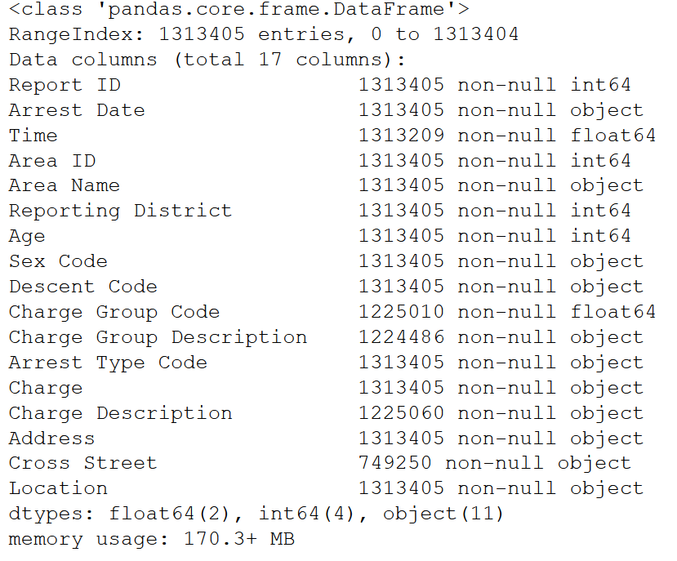
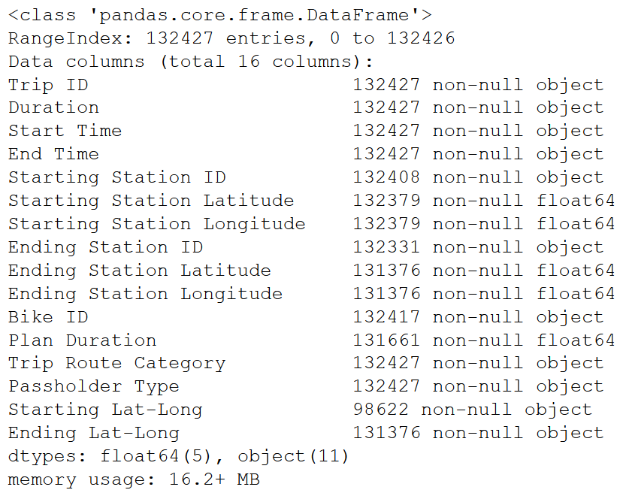
Uncleaned Datasets
Arrest: Metro Bike Share Trip:

Slide 10
Data Preprocessing
Dimensionality Reduction
Handle Missing Values
Combine/Split Features

Slide 11
Data Preprocessing
Extract the important features
Delete unnecessary dimensions
Can fix many of the missing values
Essential Features
Drop data points (rows) with missing values
If there are too many missing → replace with default value
Non-Essential Features
Replace with default value
E.g. ‘Cross Street’ missing values → ‘Unknown’
Combine/Split Features
Combine ‘Arrest Date’ and ‘Time’ features into ‘Arrest Date’ feature
Split ‘Location’ feature into ‘Latitude’ and ‘Longitude’ features

Slide 12
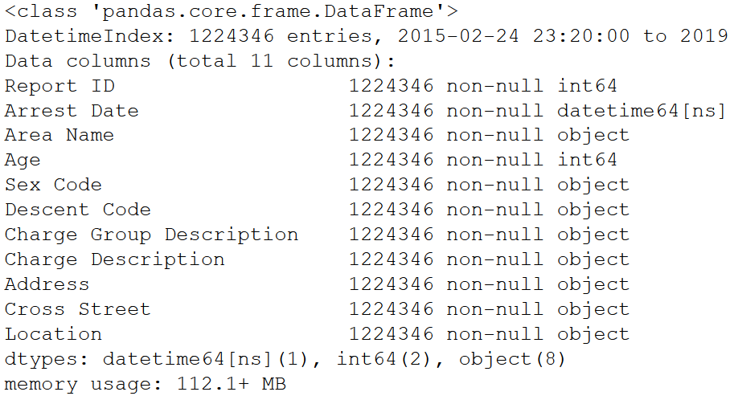
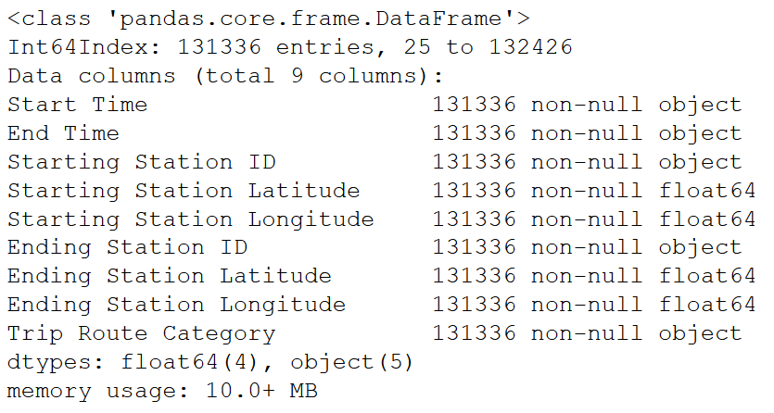
Data Preprocessing
Arrest: Metro Bike Share Trip:

Slide 13
Data Analysis
Arrest Dataset
Analysis of most frequent committed crimes
Analyse which crimes might affect bikers
Timely analysis of frequent committed crimes
Metro Bike Share Trip Dataset
Analysis of shared bike trips
Analysis of provided bikelanes
Bike Lane Dataset
Extract bike lanes to observe
Integration of Analyzes
Combine results to extract pattern

Slide 14
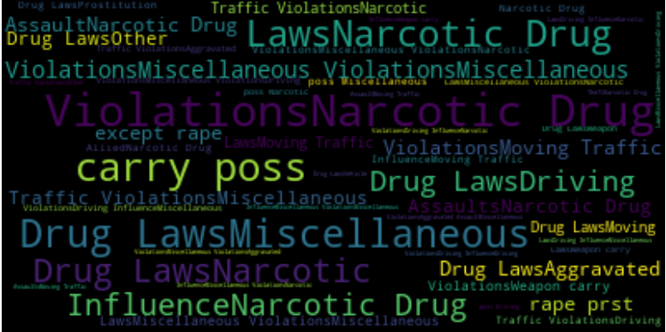
Arrest: Charge Group Description

Slide 15
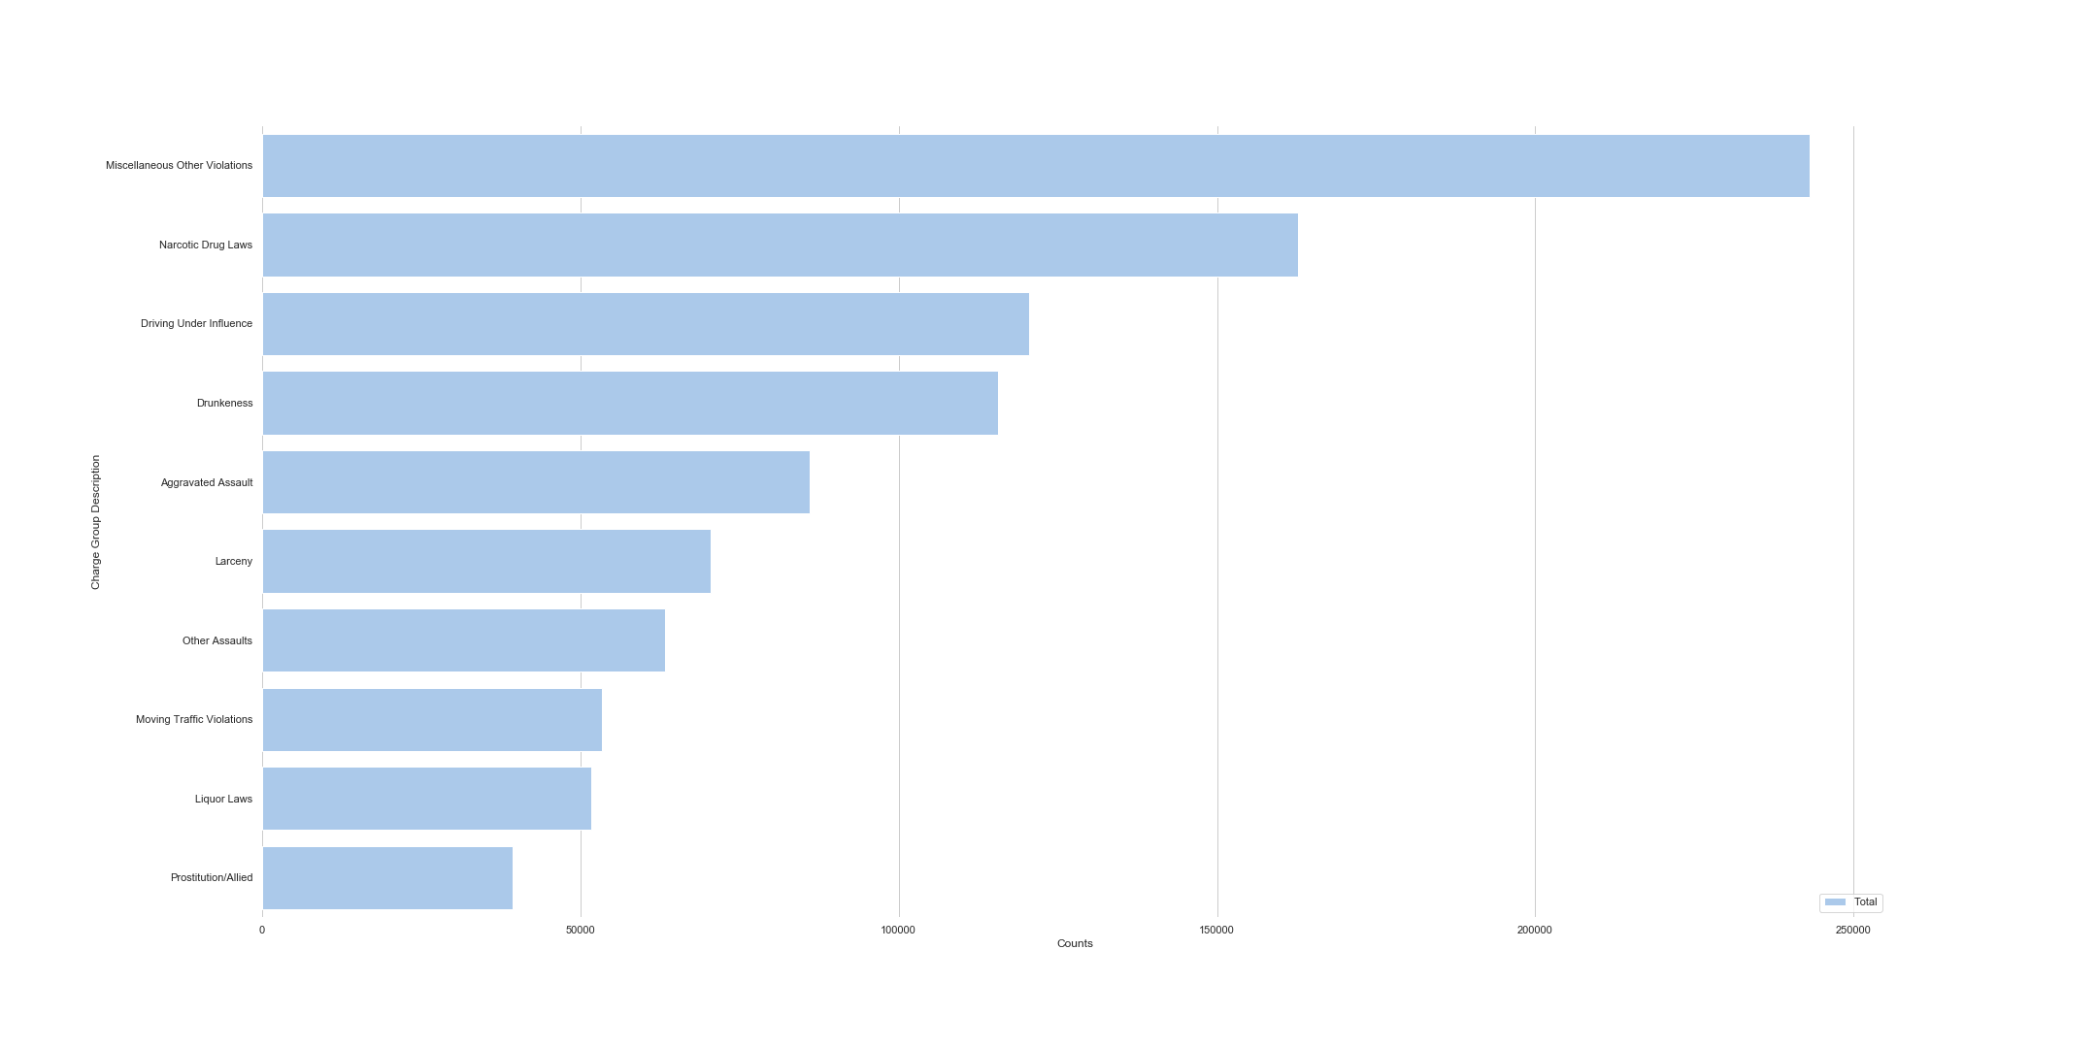
Arrest: Charge Group Description

Slide 16
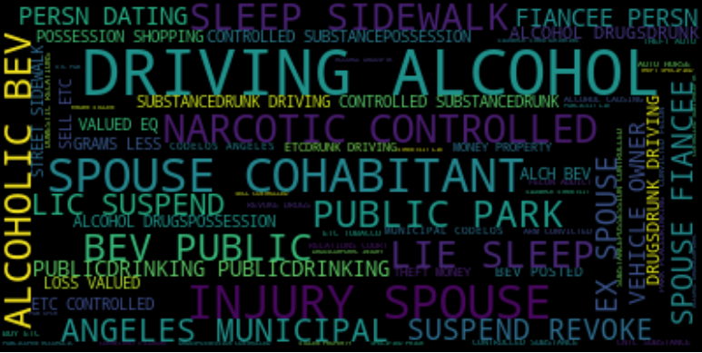
Arrest: Charge Description

Slide 17
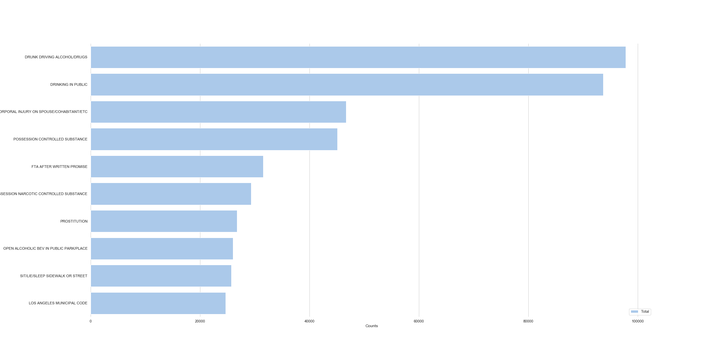
Arrest: Charge Description

Slide 18
Arrest: Extract Interesting Charges
Extract the Charges/Crimes that possibly harm bikers
Substrings within the most frequently committed crimes
Generate subsets containing different substring
Assembly those sets to one set of interest
Result
Reduction from 2319 different Charges to 289 of interest
38.62% of entries are of interest!

Slide 19
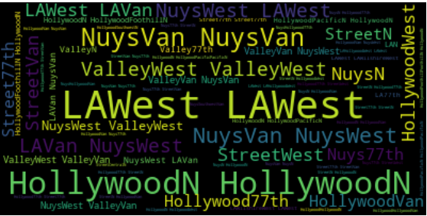
Arrest: Frequent Areas

Slide 20
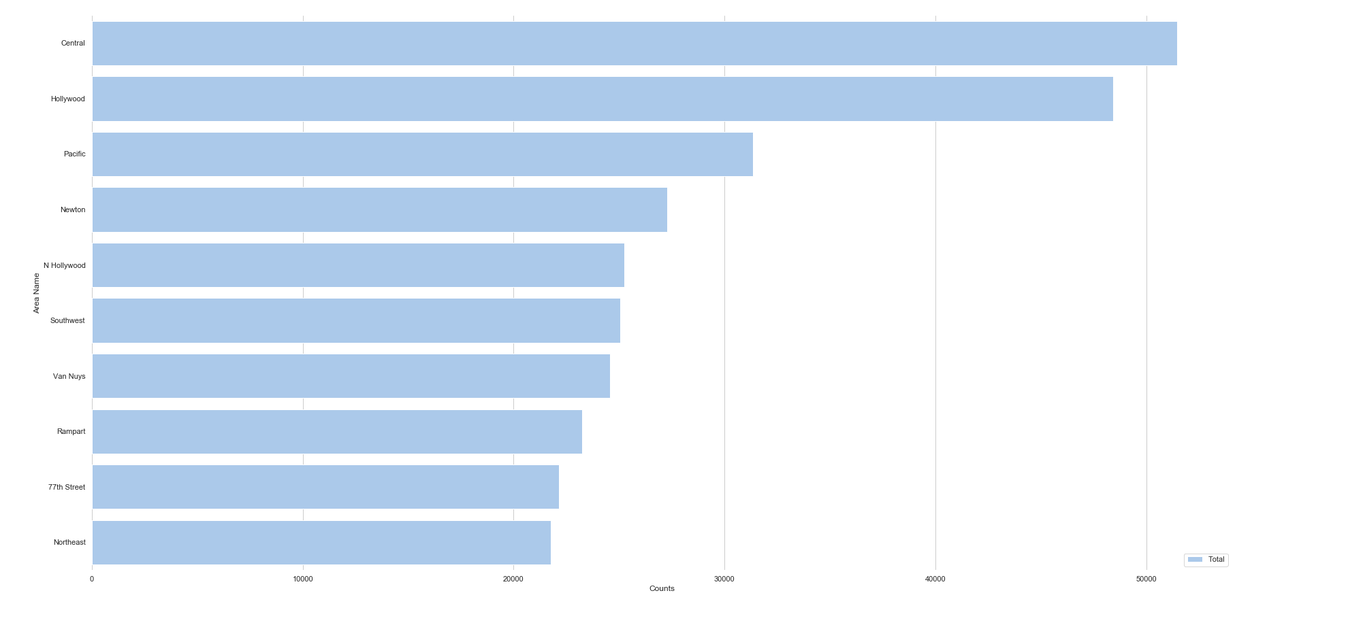
Arrest: Frequent Areas

Slide 21
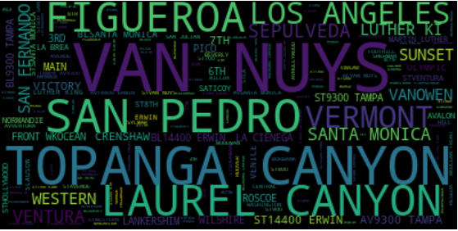
Arrest: Frequent Addresses

Slide 22
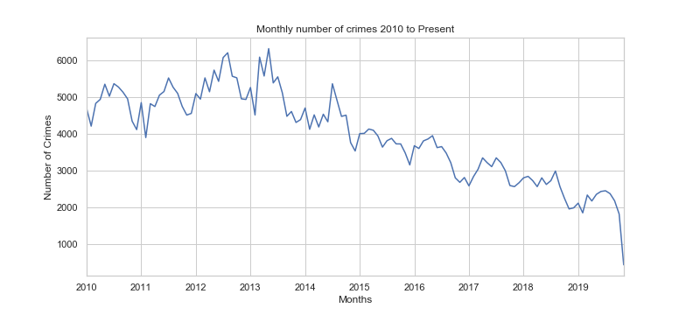
Arrest: Evolution Number of Charges
Peaking mid year
Lack of data

Slide 23
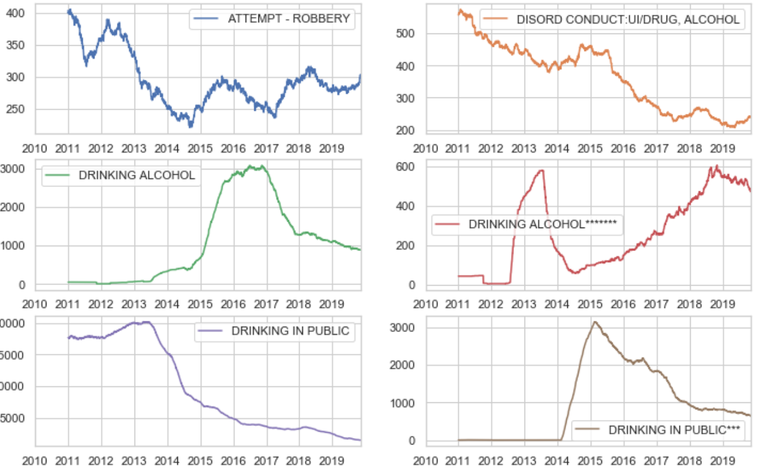
Arrest: Top 30 Charges Trends

Slide 24
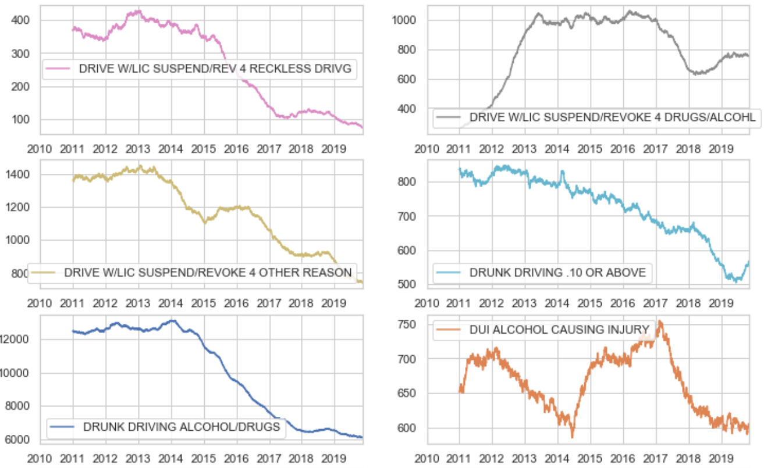
Arrest: Top 30 Charges Trends

Slide 25
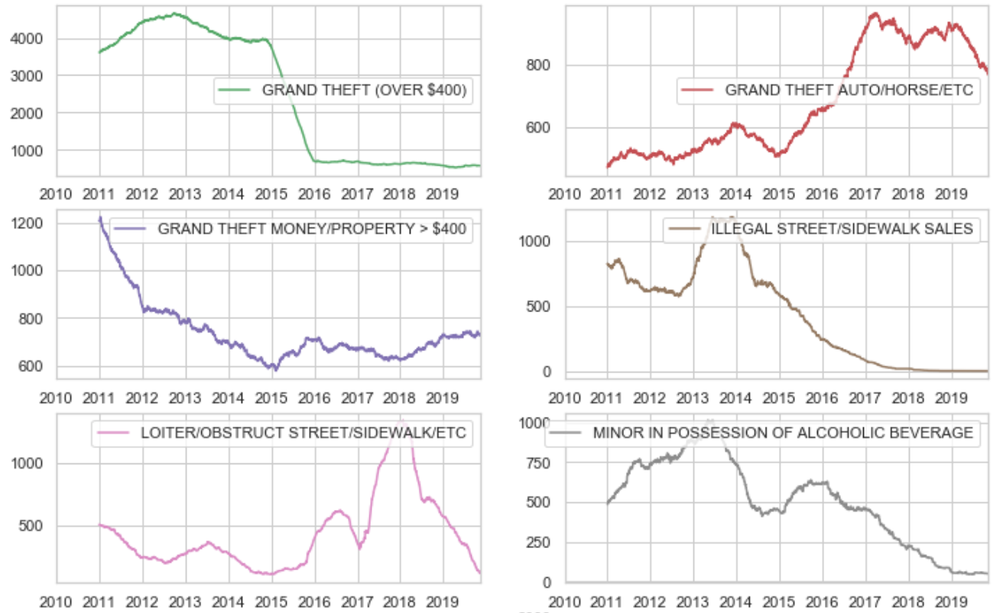
Arrest: Top 30 Charges Trends

Slide 26
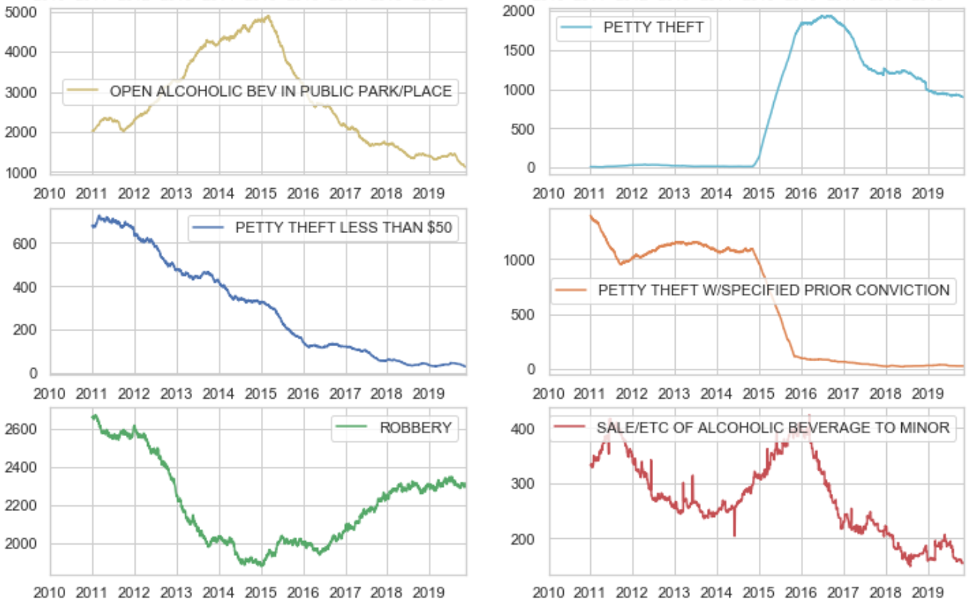
Arrest: Top 30 Frequent Charges Trends

Slide 27
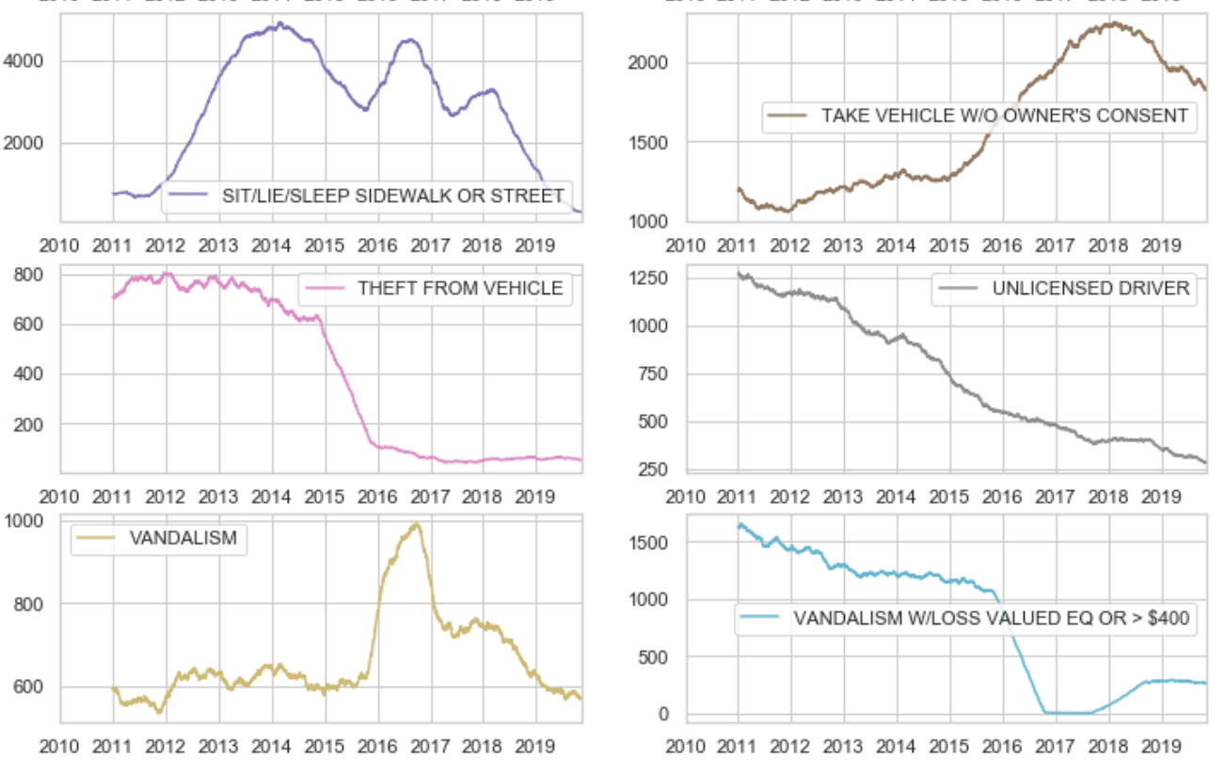
Arrest: Top 30 Charges Trends

Slide 28
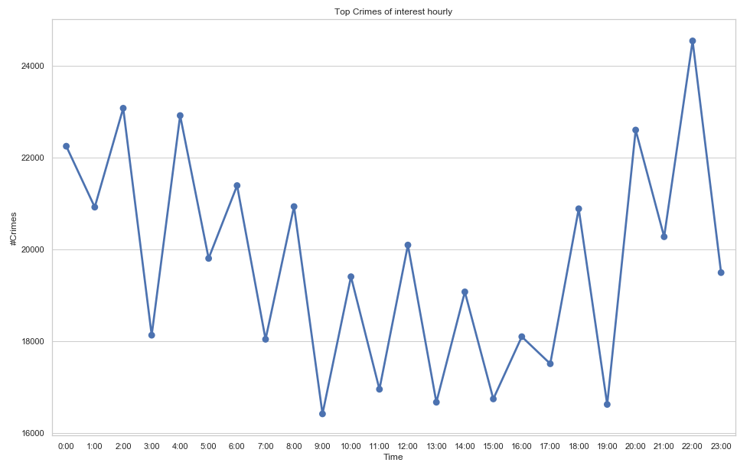
Arrest: Frequent Charges Hourly

Slide 29
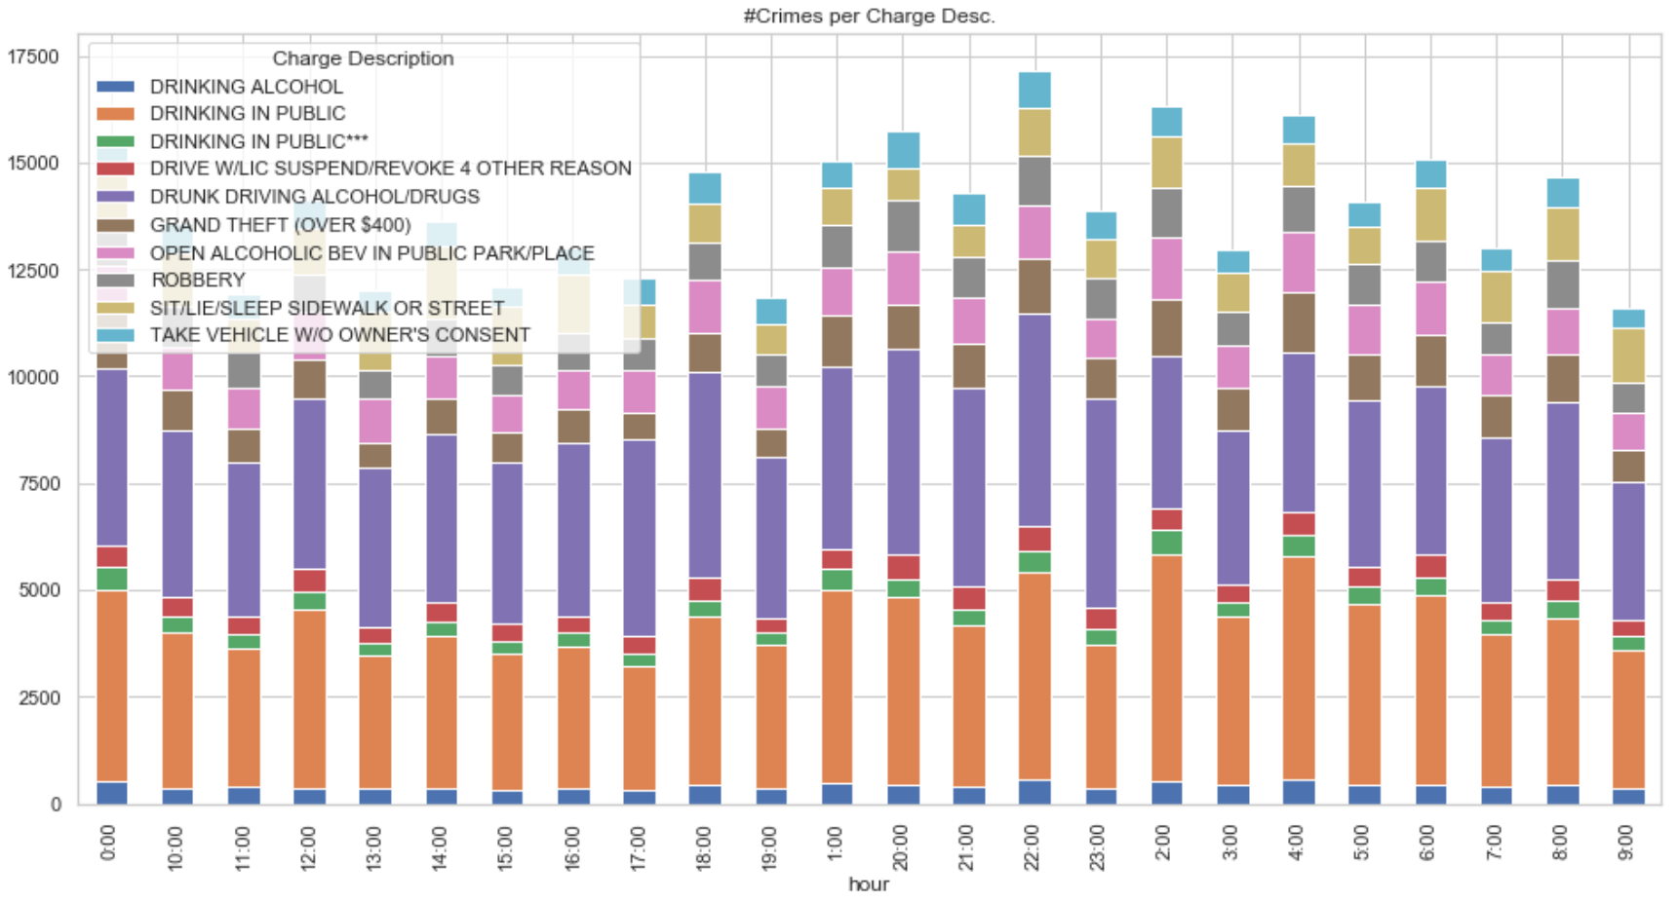
Arrest: Top 10 Frequent Charges Hourly

Slide 30
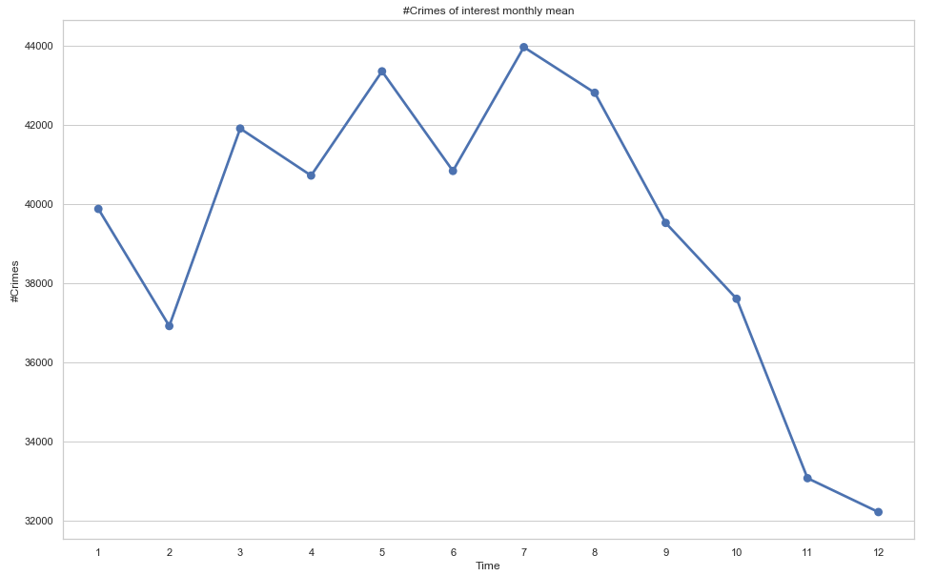
Arrest: Frequent Charges Monthly

Slide 31
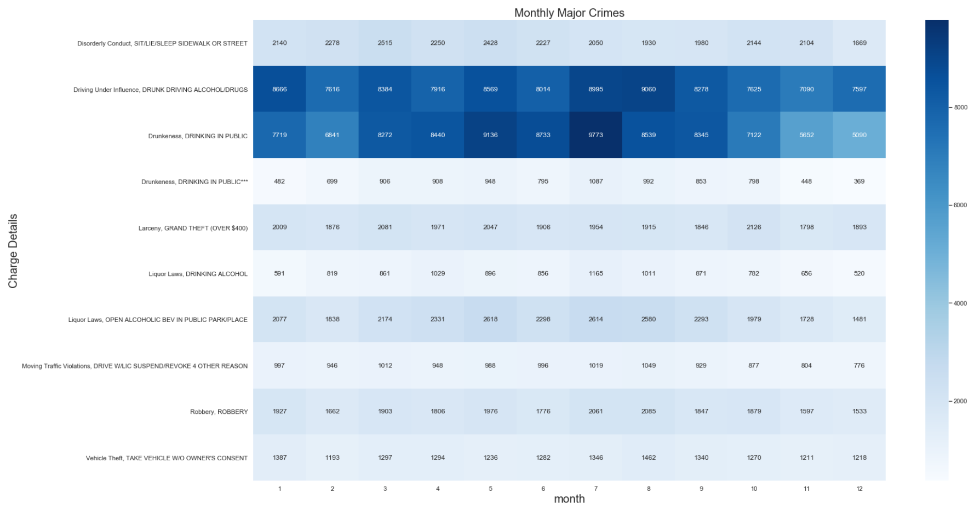
Arrest: Top 10 Frequent Charges Monthly

Slide 32
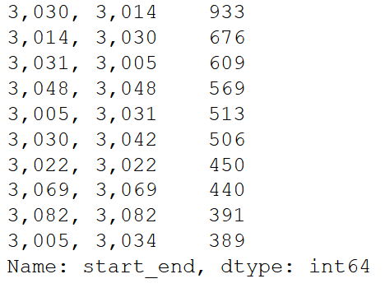
Metro Bike Share Trip
Provides 131336 rides from start to end location
Unique rides: 3580
Top 10 popular rides:

Slide 33
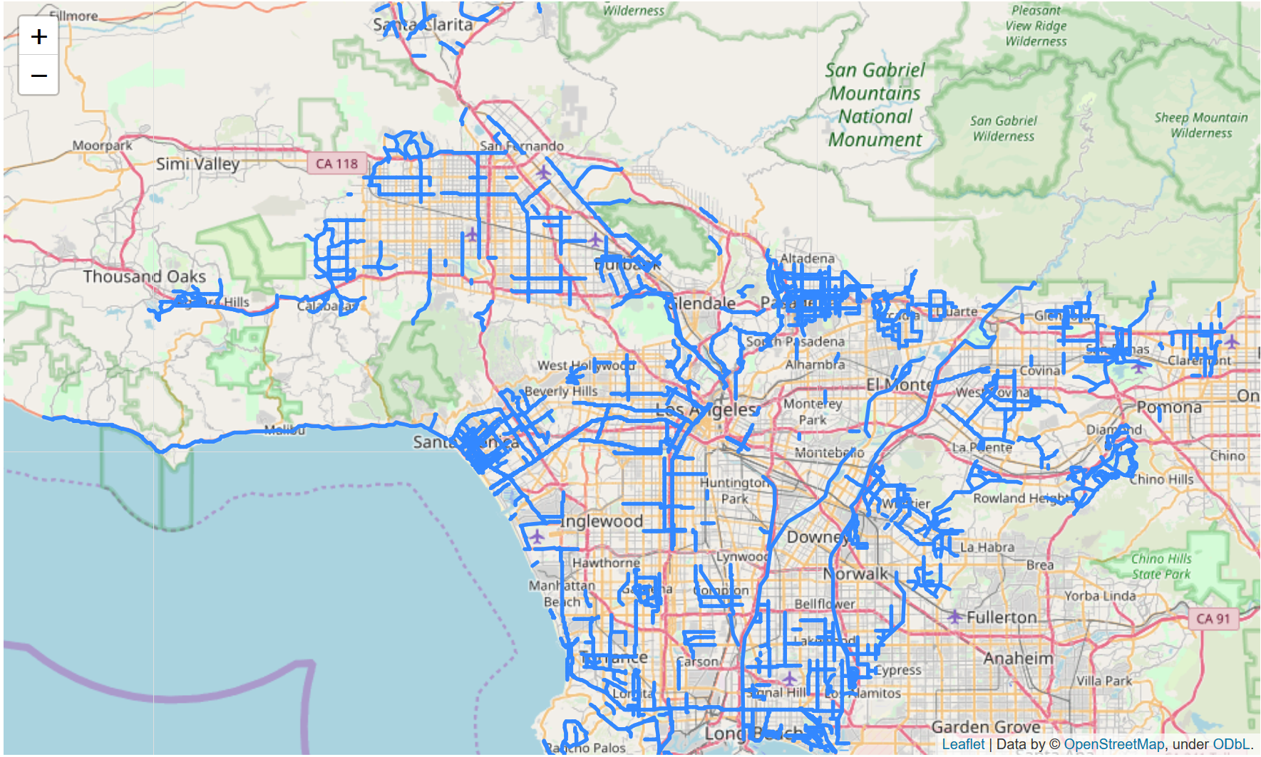
Bike Lanes: Lanes Map

Slide 34
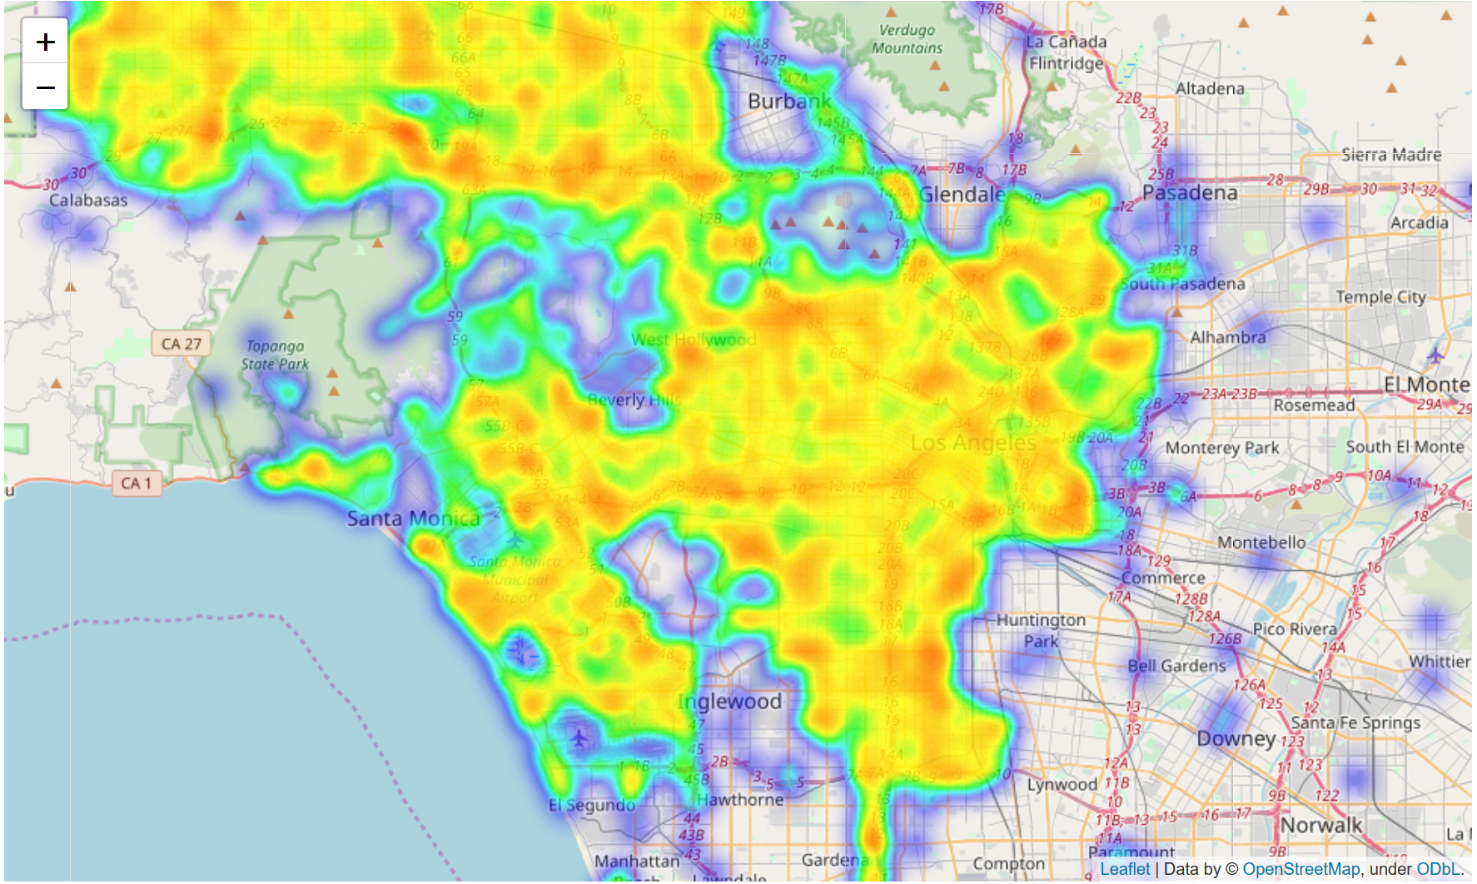
Arrest: Interesting Charges Heatmap

Slide 35
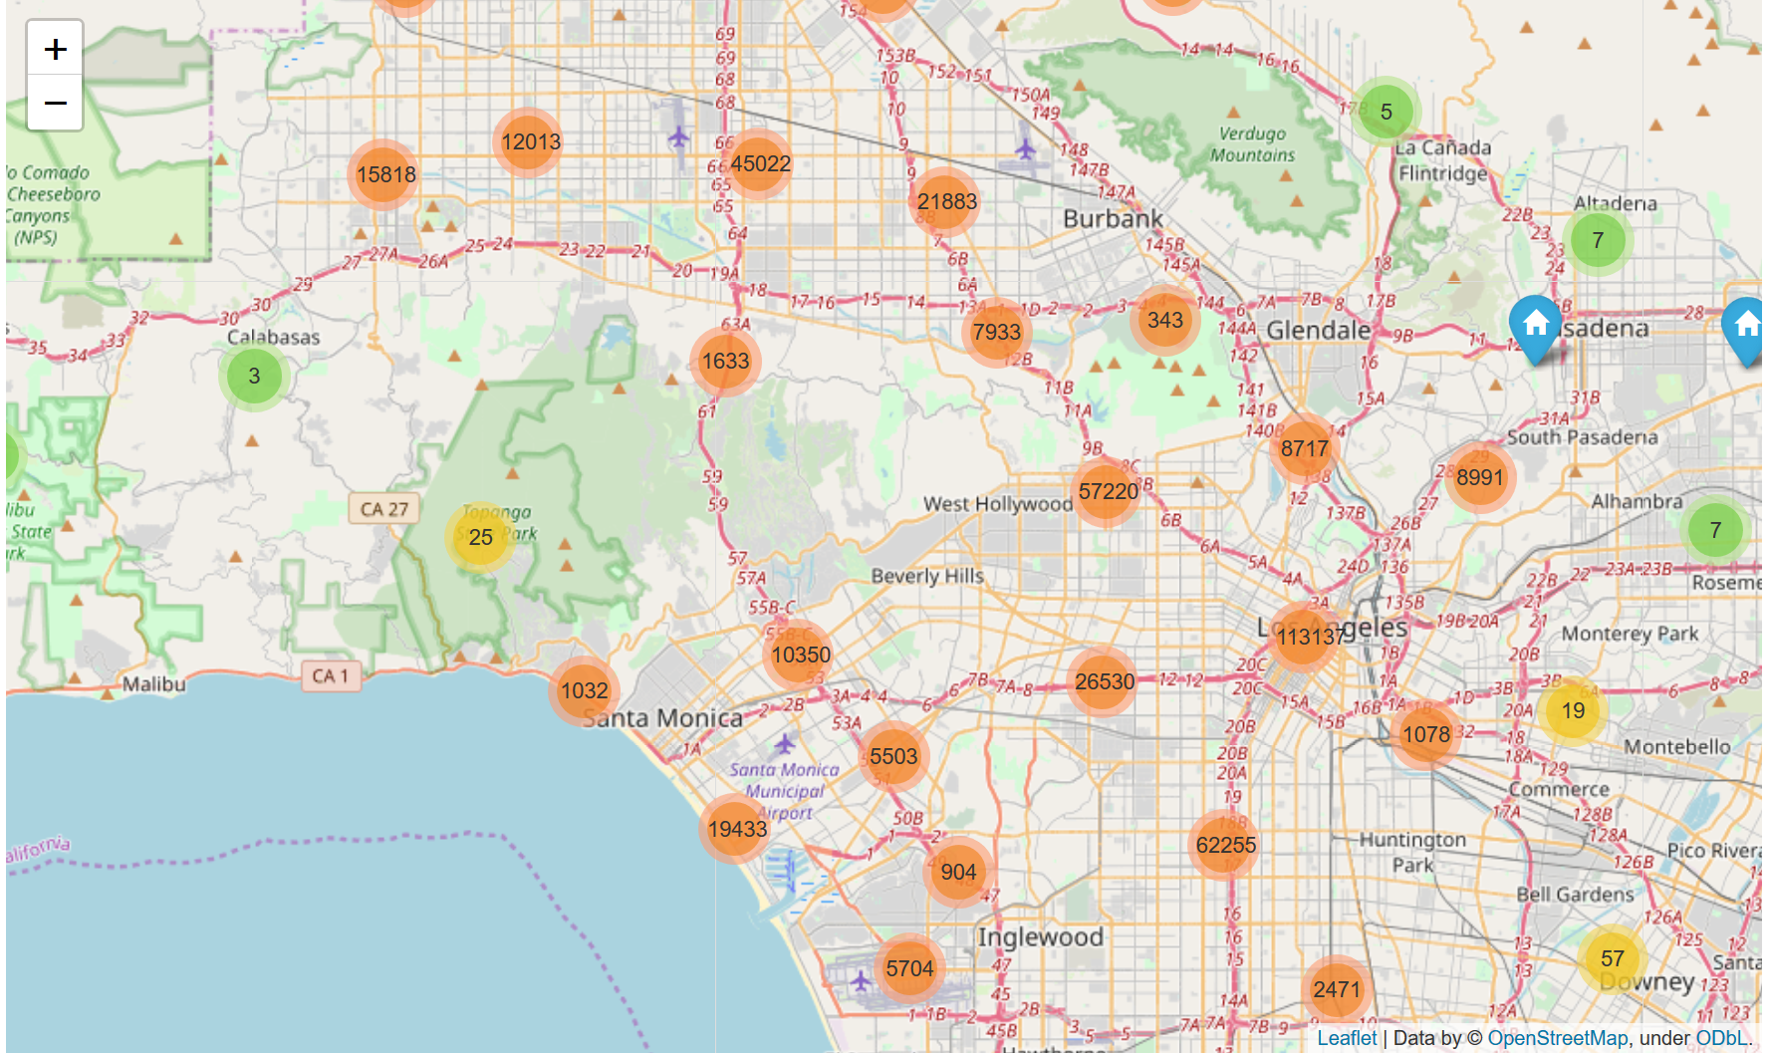
Arrest: Interesting Charges Clusters

Slide 36
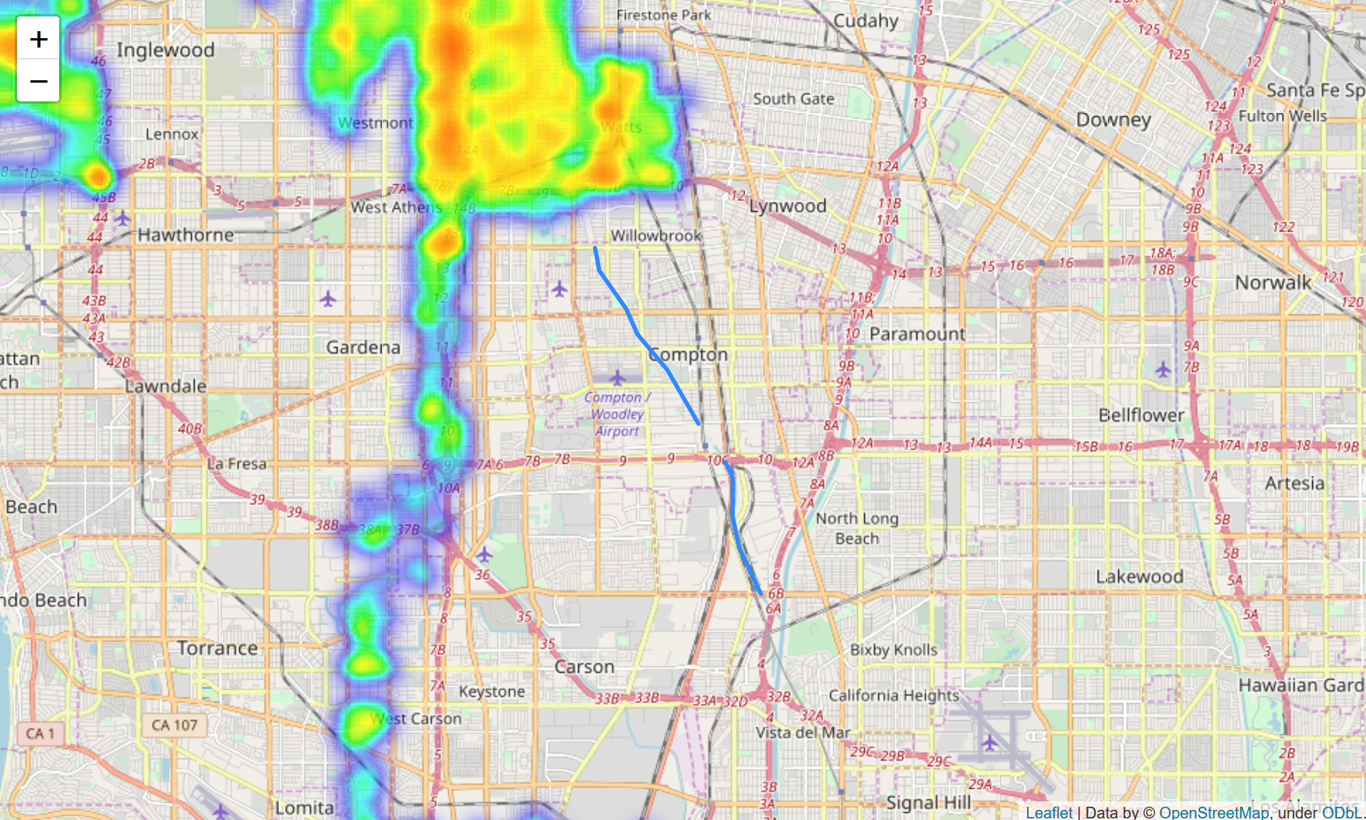
Integration: Analyse Bike Lane

Slide 37
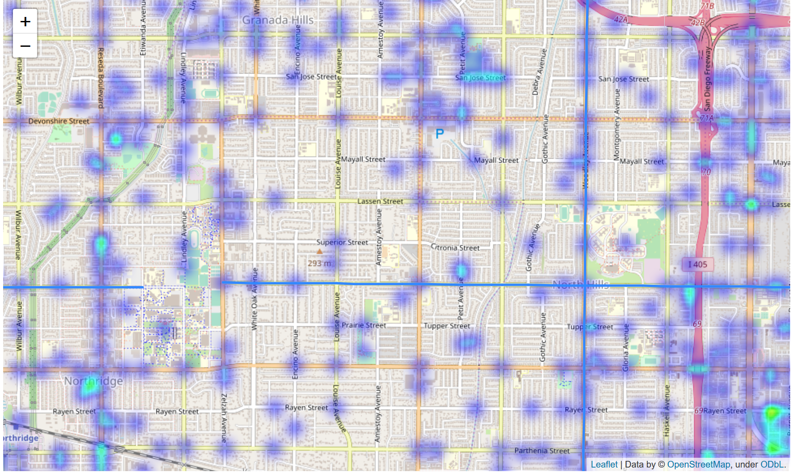
Integration: Analyse Bike Lane

Slide 38
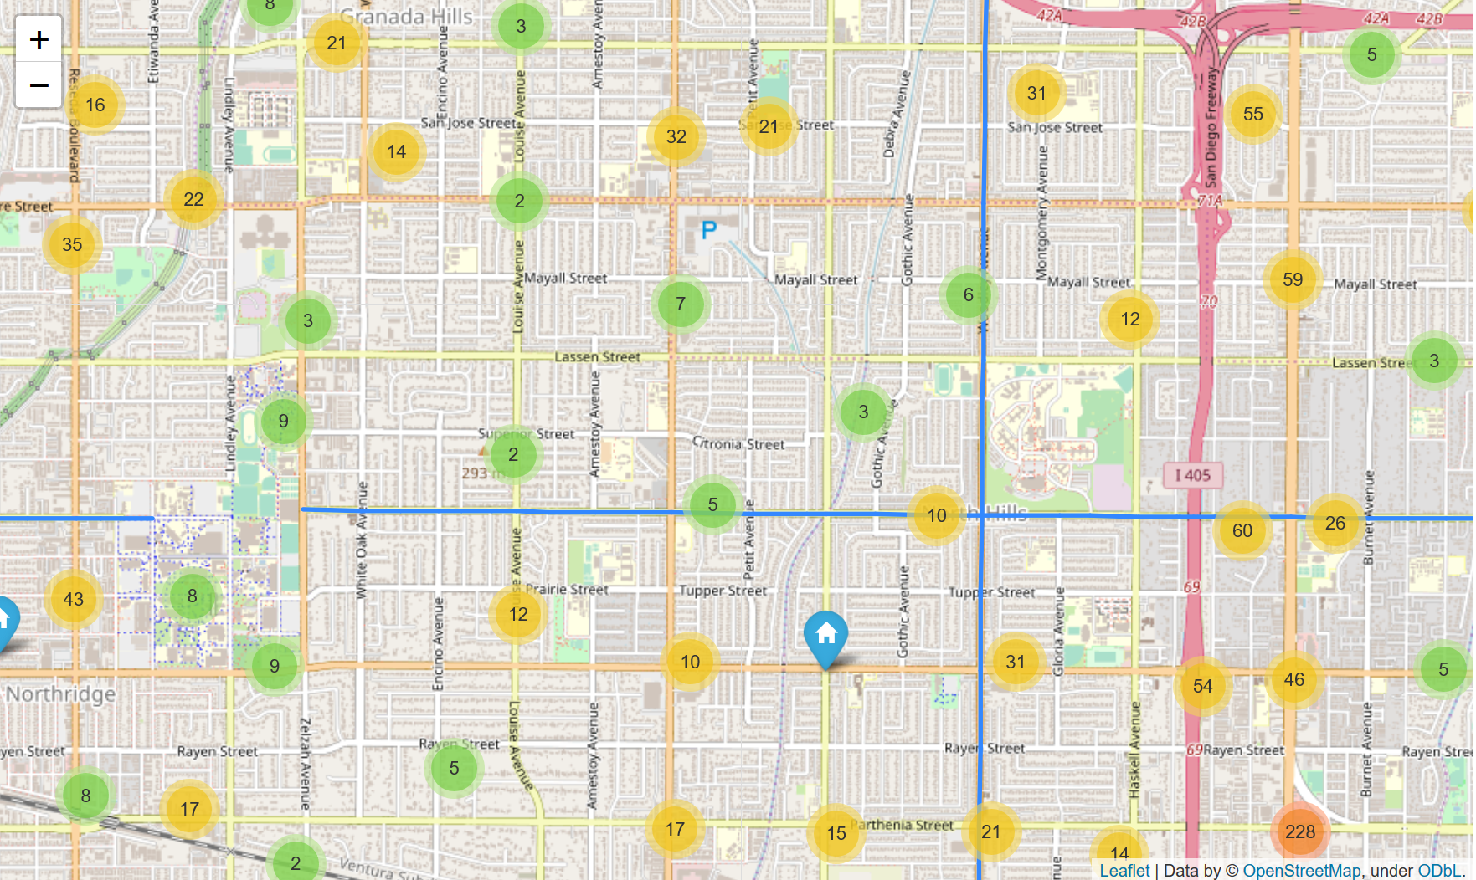
Integration: Analyse Bike Lane

Slide 39
Demo Time

Slide 40
Conclusion
Able to load specific bike lanes
Overlay processed crime dataset
Interactive map enables exploring
Can be useful in combination with time analysis

